Slide 1
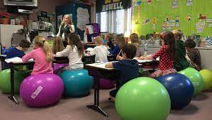
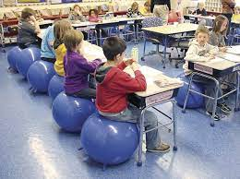

FBI
development
outside
1994 coreset
1994
docs
Walnut Tree
Patchwork famly
VIRGIN.MARY.PMS( brunette service frozen yogurt; sample)
1988 yogurt store davis unvierty mall
pms recycling
2014 HOMICE:IS-A-BELL
(10c maanger) east yougu out of sams ass
1987
1986
1983/4
1982
1981
1980
Ibm-dns:season.com
Walnut Tree
Birke
WATER.IPX.WATER
Walnut Tree
Pine Tree
000.41
lisnt(.seasons_and_trees( winter,summer,tree and plants) stadt land fluss

Slide 2

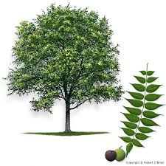

FBI
development
outside
1994 coreset
1994
Jacks off dog ( sells moped)wins lotter 777,777DM; winter spintg
KING:PX(globus):HOMCIE:LUX.St. Nick platics shoes
IPX(US-DE) summer lives in backyard
WINTER
KING.nonPoliceSummer
nonPoliceNSA.nonPolcieIncie(kkk klu klux kaln backersfield)
Drunk german avg
IPX
Summer king
Susi ?
Haouse in garden
Gorbahce(douglass fur)
Autum
Spring

Slide 3
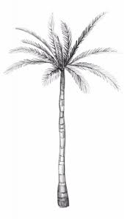
FBI
development
outside
WATER Phil(kim) n. braciforate 1981/2 2000/1/2
1987
1986
1983/4
1982
1981
1980
Walnut Tree
Ibm-dns:season.com
FBI:KIDNAPPGH:
Gary Johnson
Birke
Palm Tree
Walnut Tree
Pine Tree
000.41
lisnt(.seasons_and_trees( winter,summer,tree and plants) stadt land fluss
FBI:KIDNAPPIGN:CPVA
Kibmerlg: tertherball
Apple.nonoliceCfg(hermossa)
1986/7 offsite Moved 9 times 2 years
41.ATOMCLOCI(CPVA.nonPoliceF)MARK(HOMSITE:SUNSTORK)
Gobache(Cooly) DR. Rice Baseball Trhor Presidental

Slide 4


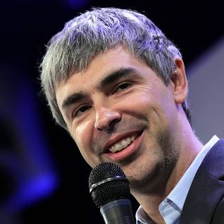


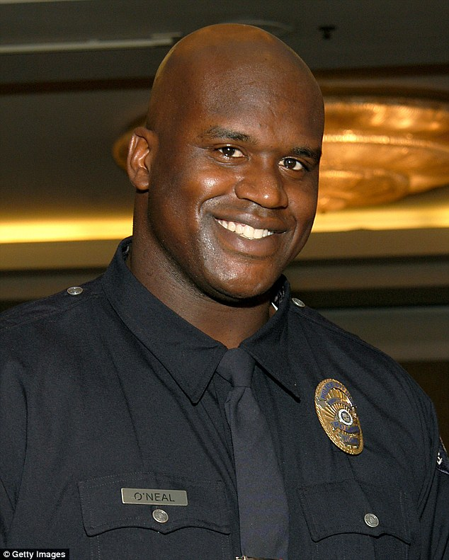

FBI
development
outside
KING:HOMCIDE:LUX:COINTOWN:HATEHOLE:ST NICK
twins
FBI:KIDNAPING.v0
Twins/twinners
HOMCIDE:SUNSTORKE
December 24th, 2014
WINTER
1994
VUIRIGN MARY.Stanford.pmp.snoopdoggydog
docs
KING:HOMCEI:LAWNHOLE
VIEING.JSOOEPH.MARY
88th.rheinaard.
88th.stenafaph.
1987 wonder years jewish
LARYY
FBI:KIDANPPIG.v2
nonPocleiWife(Gheoho(michal)
Stanford
Yang,page,bring,woods
Douglass Fur
docs
docs
1994, 2005
41.FBI:WMD:GREEN
41.1D8723 what is this
PREA fiddling, Thomas-is-dieter,kalrry page, serbinb
Zuvkerbert
cook
IMPORT ibm.google CHECKPON CHALIRE(wall,larry wofenstein)
Gohrohe(micheala)

Slide 5


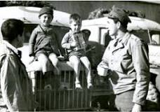
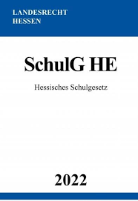


FBI
development
outside
VIRINGA.MARY
CHECKPON CHARLIE
WW2.HOMCIDE:NANA:”GUM”
1991
44^{th Dictat 6.0,6.0,6.0}
8th
2005 Thesies 1.7
MATHAISEE(1.3)
Os 4.0
PENTAON BASE PX MUSIC
AIRBASE:RHEIN-MAIN:Schutlzgesetz
VIRGINA MARY.Stanford.pmp.snoopdoggydog
He is in 7th
HOMCIDE:CHANLOR(elke)
41
KING.SECTARY
WW2.HOMCIDE:NANA:”GUM”
1991
KING.PRINCIPAL
44th
88th
Sectary of State
By the 1940s chewing gum became unexpectedly linked to patriotism and civic duty. During World War II, gum featured in every soldier's meal rations. Chiclets, spearmint and orbit provided a small relief to men and women overseas, with an estimated 630 sticks of gum consumed by every serviceman or woman.
CIVIL CODE: VIRINGA.MARY.44th.88th SCHOOL
41.JOESPH aei.maxplan !6.0.!.6.0
Einstein 88th

Slide 6


FBI
development
outside
CHECKPON CHARLIE
1991
44^{th Dictat 6.0,6.0,6.0}
8th
2005 Thesies 1.7
MATHAISEE(1.3)
Os 4.0
1994
1990
Ddr(ricardo)
JOESPHE

Slide 7
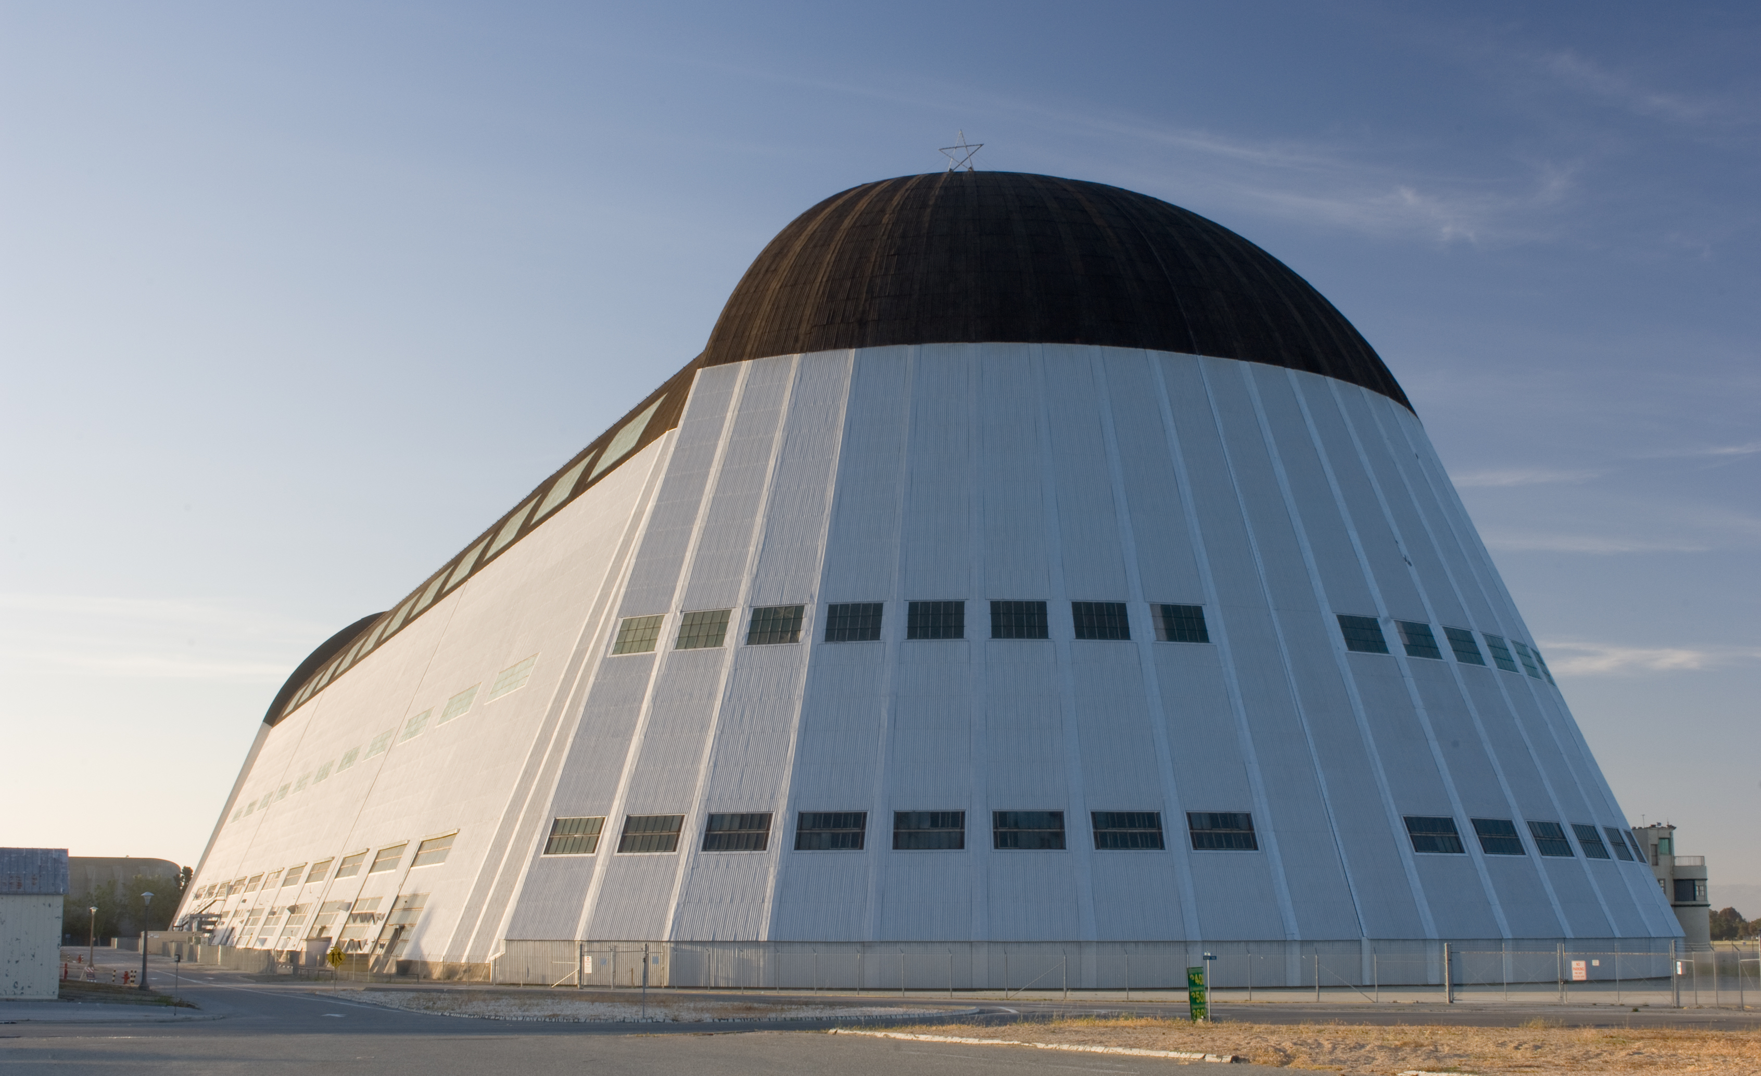
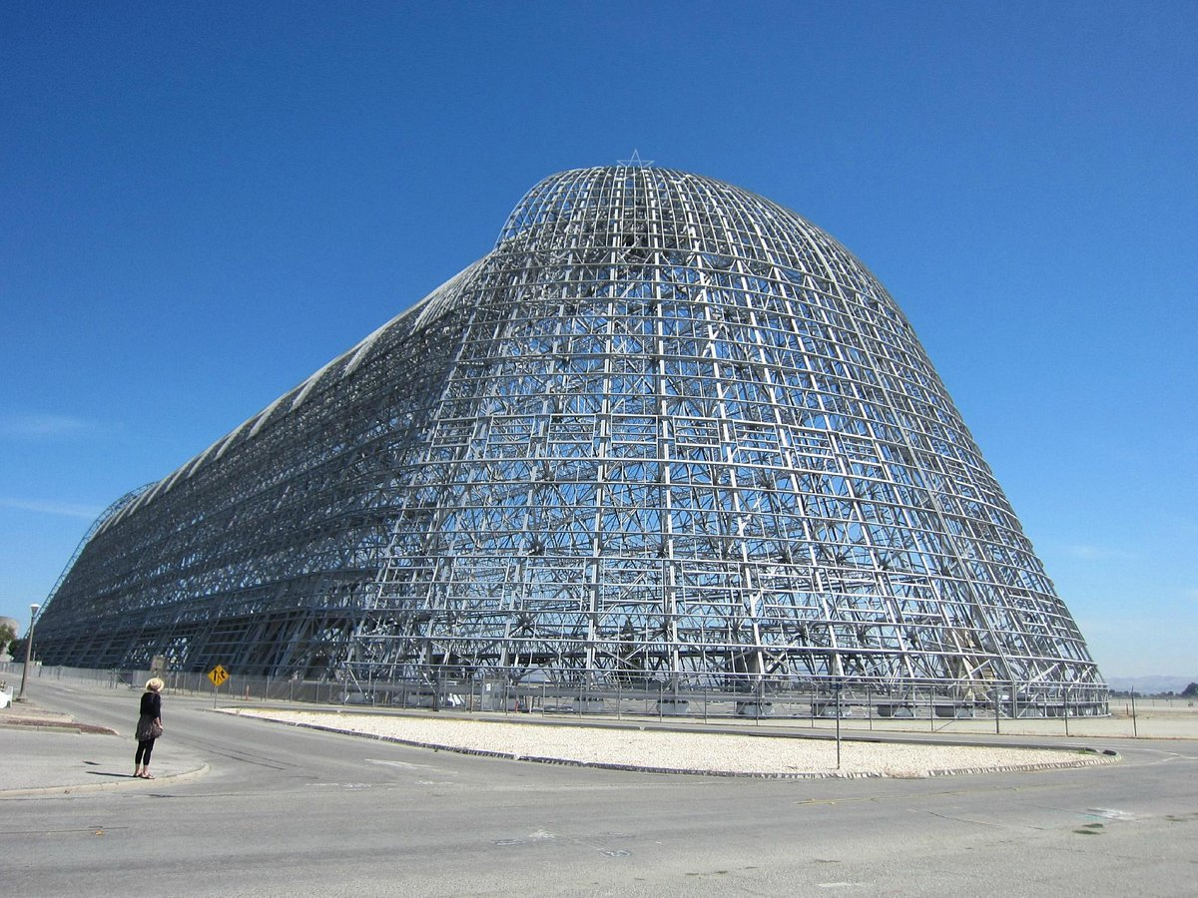
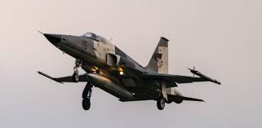
FBI
development
outside
CHECKPON CHARLIE
1991
44^{th Dictat 6.0,6.0,6.0}
8th
2005 Thesies 1.7
MATHAISEE(1.3)
Os 4.0
IMPORT ibm.google CHECKPON CHALIRE(wall,larry wofenstein)
41.LARRY.PRICE.MAGIC
!HOMICIDE:AUSLAENDER
AUSCHITZ.TRAIN.!INVERT
IPX ATOMCLOIC(ATOMTIMER((cook,gorbhceo(seitz)))
mig
Decommsion
Larry page, sergay bring, tim cook,jerry yang, elon musk
Apple.tang.jerry

